Slide 1
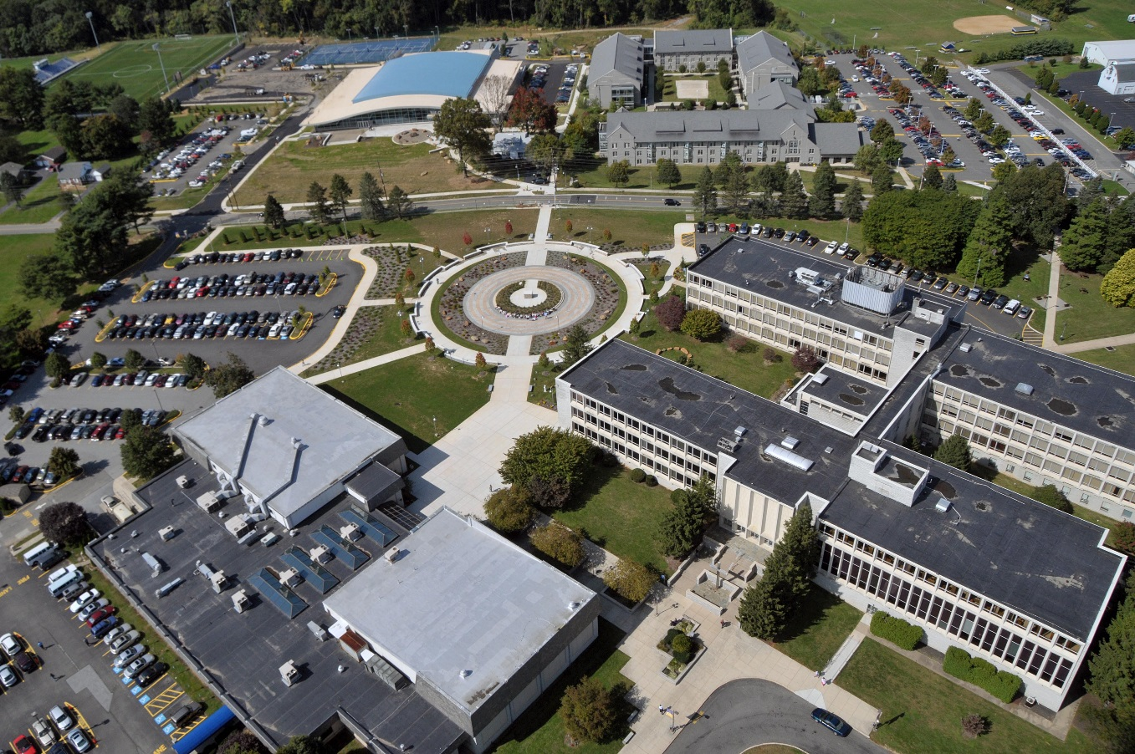
Program
at Neumann University

Slide 2
TRIO – Student Services Program
TRIO-SSS is federally funded under Title IV and managed by the Department of Education.
More than 1,000 colleges and universities offer TRIO-SSS Programs.
TRIO-SSS funds are obtained through a 5-year grant competition.
Neumann University’s TRIO-SSS Program extends to 2025, at which time it will be up for renewal.

Slide 3
Neumann University’s TRIO – Student Support Services Program
Neumann University’s TRIO-Student Support Services (SSS) Program helps students progress each semester and develop academically and personally to graduate and achieve success. The TRIO Program’s goal is to see our students remain in college, increase their GPA, and graduate with the least amount of debt possible.

Slide 4
Mission Statement
The TRIO program’s mission mirrors that of the University – to encourage life-long learners and to educate a diverse community by sharing the gift of knowledge in serving others.

Slide 5
Academic Commitment to TRIO-SSS Participants
One-on-one academic coaching to help students achieve academic goals and increase their GPA;
Course selection assistance;
The possibility of earning grant aid;
Financial literacy and financial aid counseling;
Counselor coordinated TRIO/university tutoring;
Career and internship counseling; and,
Graduate/professional school counseling.

Slide 6
Who is Eligible for the Program?
Although not all students will qualify for the TRIO Program, those selected must be:
US citizens or permanent residents eligible for federal loans or grants,
pursuing their first bachelor's degree, and
freshman or sophomore students who are academically in need of services.
Students must also be one or more of the following:
income eligible as defined by the US Department of Health and Human Services Poverty Guidelines;
the first generation in the family to attend college with neither parent nor the parent or guardian with whom you live having graduated from a four-year college or university or you are independent; and/or,
Have a documented disability on file with Accessibility Services.

Slide 7
Applying for the TRIO Program
The TRIO Program application can be found on the Neumann University TRIO website. Separate applications are available for dependent and independent students.

Slide 8
Scheduling an Interview
Once the TRIO office receives a completed application, the student is contacted to set up an interview. Please be ready to provide some dates and times for the interview.

Slide 9
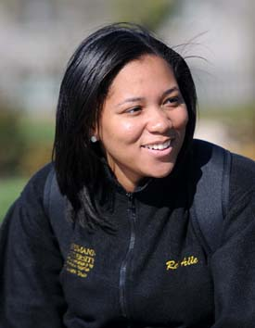
How Does TRIO Select Students?
With a limited number of acceptances, the TRIO-SSS Program staff will interview and select applicants based on eligibility criteria and the applicant’s intent to fully use the program’s services and to graduate.
The TRIO-SSS Program gives priority to:
Incoming freshmen and sophomores who are either income-eligible, first generation, or both and full-time;
Incoming freshmen and sophomores who have a documented disability.

Slide 10
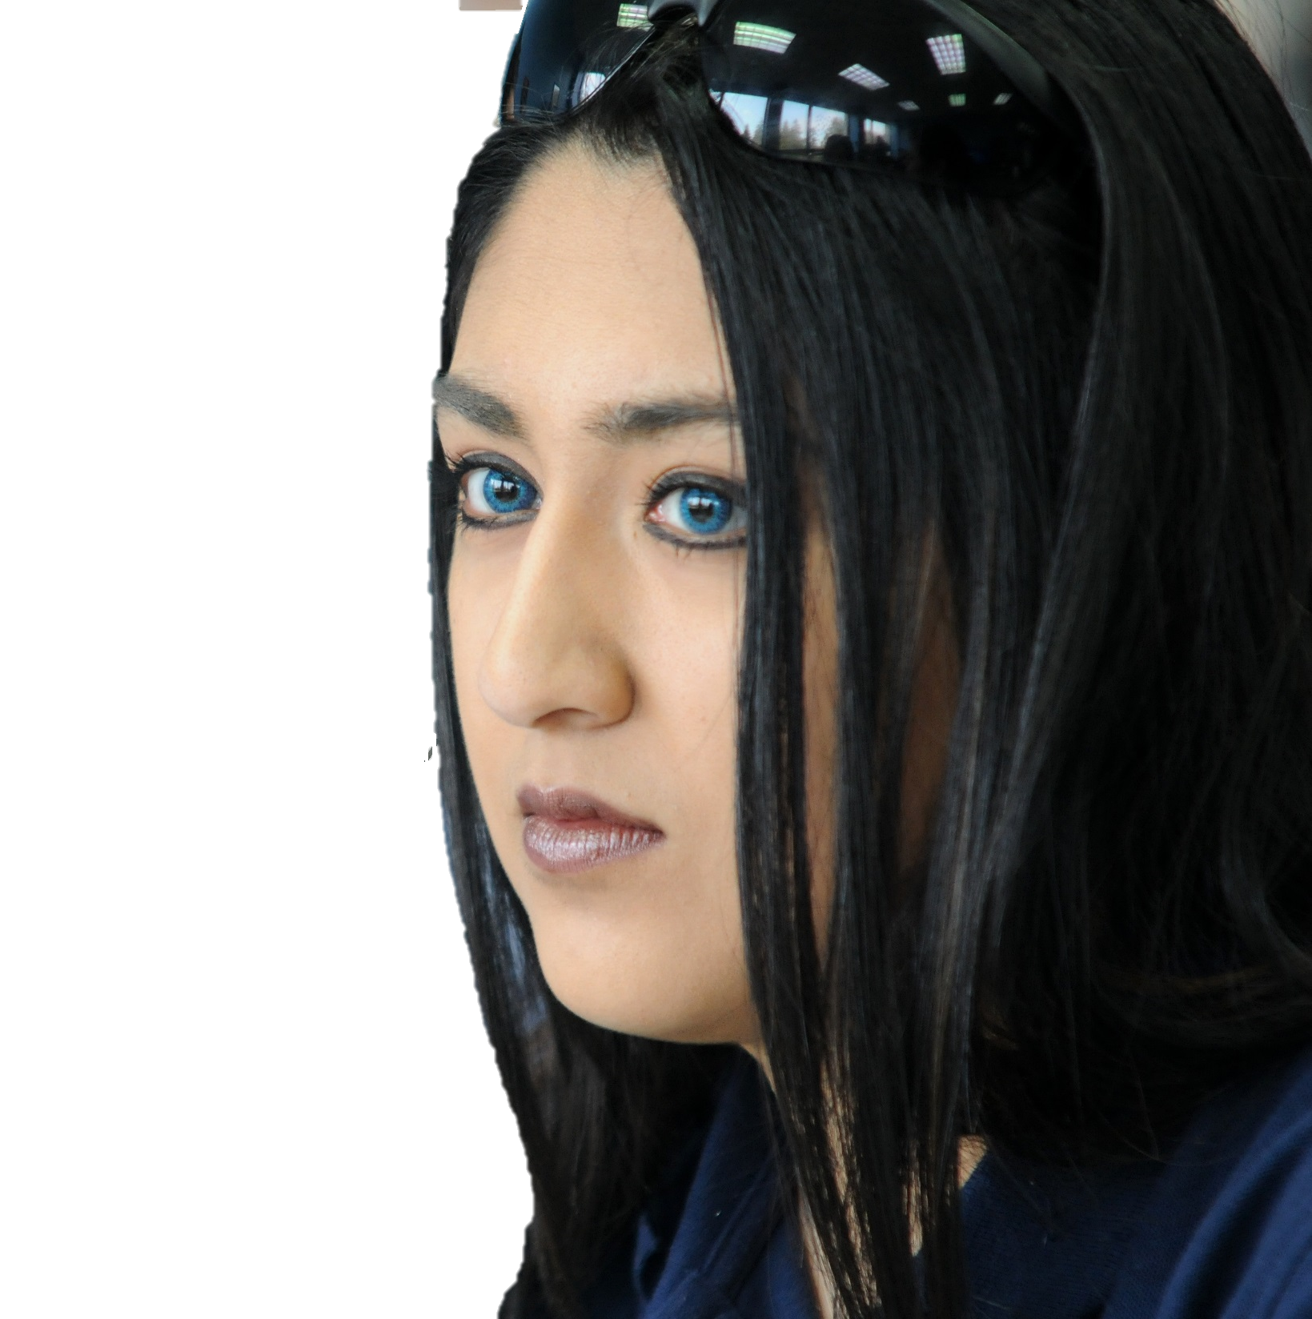
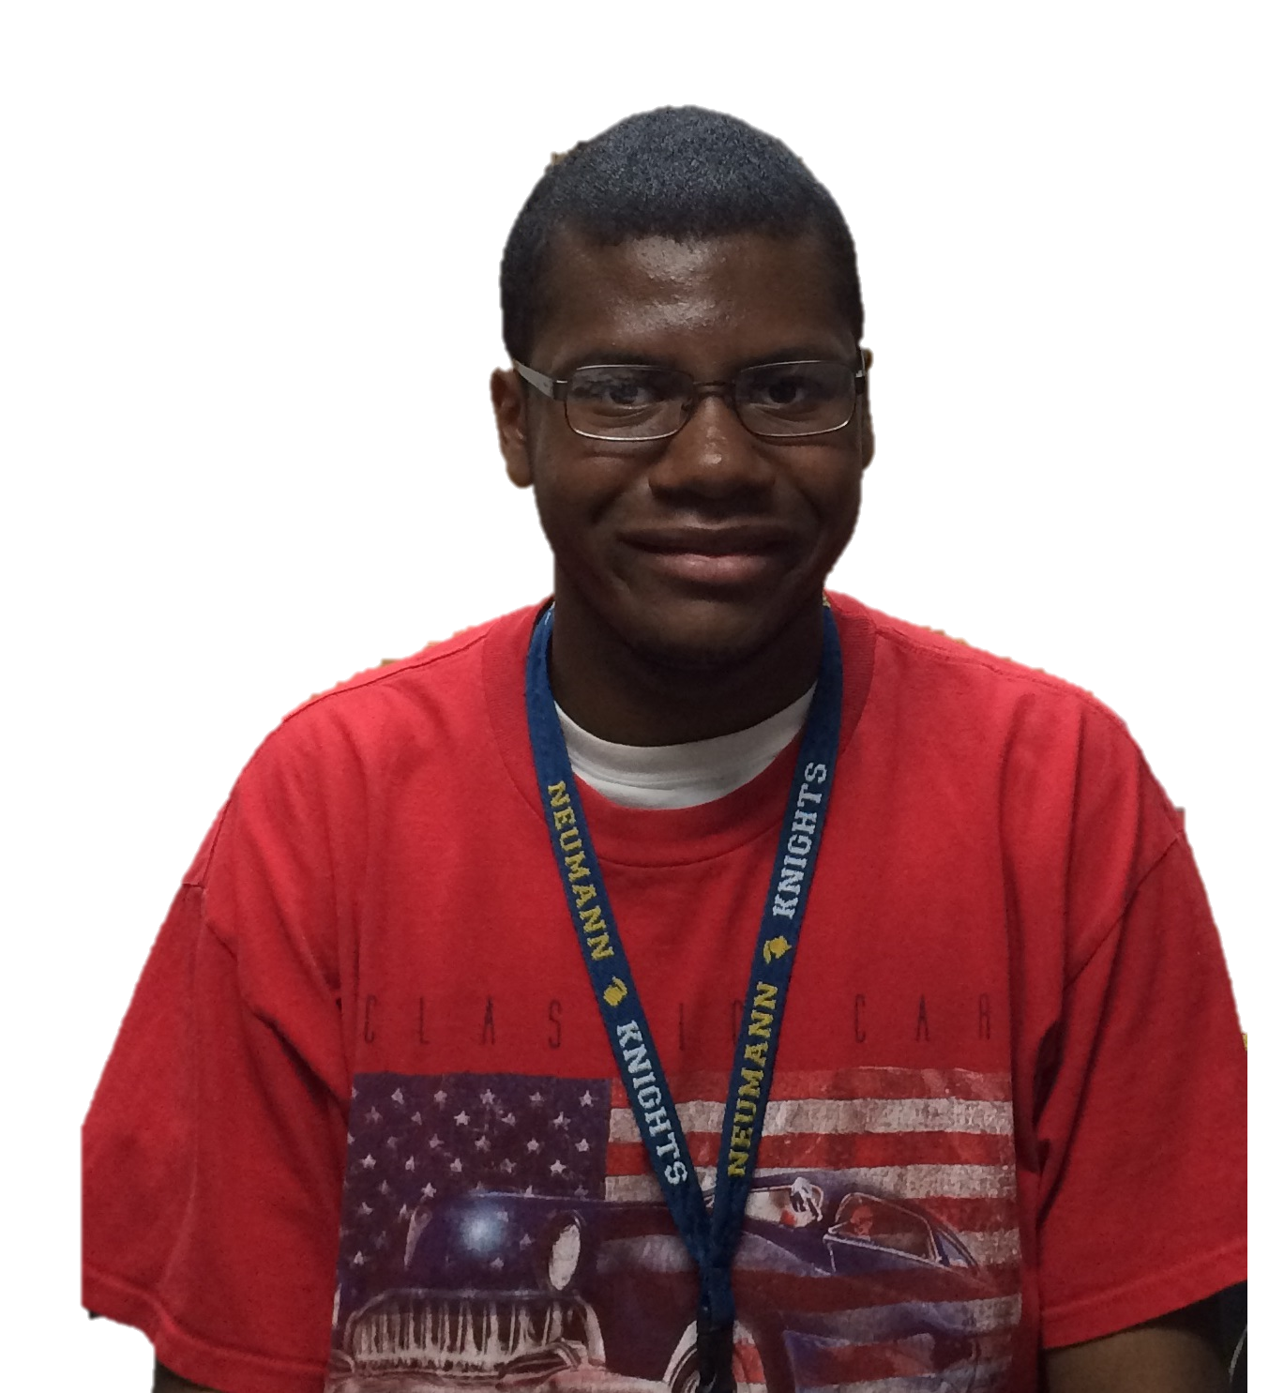
Neumann University’s TRIO Program Student Recommendations
Here is what some of our students are saying about the TRIO Program:
“The TRIO Program has helped me get organized with my academic work and advised me with financial problems.” - Laila Sheriff
“TRIO is one of the greatest support systems I have at Neumann and has really helped me during my academic career.” - Nicole Mortimer
“The thing I like about TRIO is that I can stop in the office whenever I want and just talk about anything. I also like how they offer reserved tutoring in writing, math, and other courses. Another thing I like about TRIO is that they offer assistance with resume writing.” - Maryam Ahmadi
“TRIO is concerned for its students and wants to see them succeed. TRIO wants the best out of its members.” - Josiah Blodget

Slide 11
Neumann University’s TRIO Program Student Recommendations
“TRIO has helped me in more ways than I could have imagined. One thing I love about the program is the great support and encouragement from everyone in the office.” - Rayanna Williams
“The TRIO Program is extremely helpful! They are always there when I need them and they offer me great guidance when I feel that I have to face things alone. They’re amazing!” - Amber Clements
“I love the TRIO Program, because they help me fulfill my goals and the counselors are always willing to help me succeed academically.” - Josh Hendrickson
“Everyone should join TRIO. They want you to graduate in four years and will do everything in their power to help you.” - Anthony Pino

Slide 12
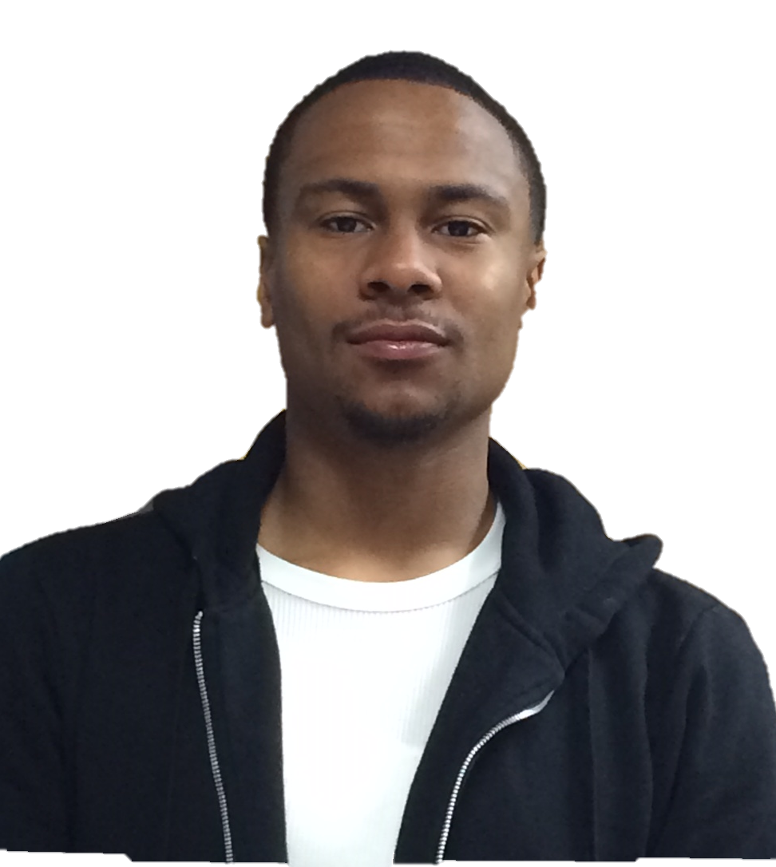
Neumann University’s TRIO Program Student Recommendations
“TRIO is a great program providing academic support. I like the fact that TRIO helps find money to pay off my bill for the end of the semester.” - Ruth Rene
“Being a part of TRIO has allowed me to grow academically and personally preparing me for my future at Neumann and for my future career as a nurse!” - Erin Monaghan
“TRIO is a great experience that I recommend for all incoming freshmen to take. They care for you and make sure you succeed.” - Ryan Bibbs

