Slide 1
What You Need to Know About Financial Aid

Slide 2
What is Financial Aid?
Financial aid is any funding to help offset the cost of college, such as loans, scholarships, grants and work-study.

Slide 3
What is Cost of Attendance (COA)?
Tuition and fees
Room and board
Books and supplies
Transportation
Miscellaneous personal expenses

Slide 4
What is Expected Family Contribution (EFC)?
Measurement of student’s and family’s ability to pay postsecondary educational expenses
Student contribution
Parent contribution
(for dependent students)

Slide 5
What is Financial Need?
Cost of attendance (COA) – Expected family contribution (EFC) = Financial need

Slide 6
Categories of Financial Aid
Need-based aid
Non-need-based aid

Slide 7
Types of Financial Aid
Scholarships
Grants
Work-Study Employment
Loans
Self-Help Aid
Gift Aid

Slide 8
Sources of Financial Aid
Federal Government
Employers
States
Private Sources
College and Universities

Slide 9
Federal Student Aid Programs
Federal Pell Grant
Federal Supplemental Educational Opportunity Grant (FSEOG)
Teacher Education Assistance for College and Higher Education (TEACH) Grant
Federal Work-Study (FWS)
Federal Direct Student Loans (Direct Loans)
Iraq Afghanistan Service Grant
Federal PLUS Loans

Slide 10
Free Application for Federal Student Aid (FAFSA®)
Collects demographic and financial information used to determine EFC-Expected Family Contribution
Colleges use EFC to determine eligibility for federal and state financial aid
May be filed at any time during an academic year, but no earlier than October 1st prior to the academic year for which the student requests aid
For the 2021-22 academic year, the FAFSA may be filed beginning October 1, 2020
Neumann University School Code 003988

Slide 11
Benefits of Using FOTW or myStudentAid
Built-in edits to prevent costly errors
Skip-logic allows student and/or parent to skip unnecessary questions
Option to use Internal Revenue Service (IRS) Data Retrieval Tool to import tax data
More timely submission of original application and any necessary corrections
More detailed instructions and “help” for common questions
Ability to check application status online
Simplified application process in the future

Slide 12
FAFSA on the Web (FOTW)

Slide 13
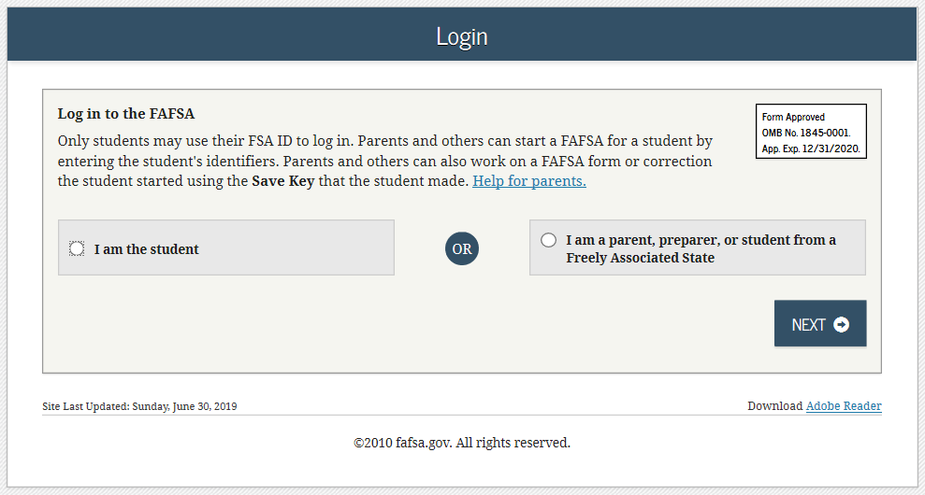
FAFSA on the Web (FOTW)

Slide 14
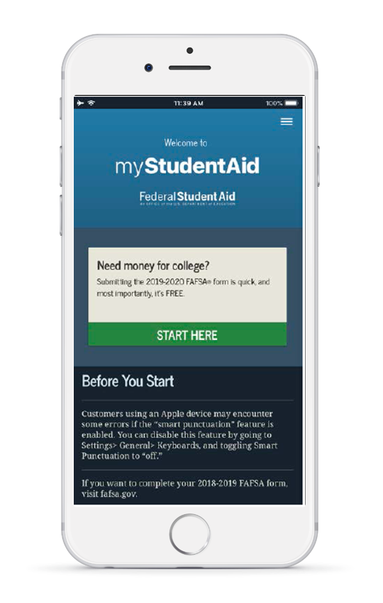
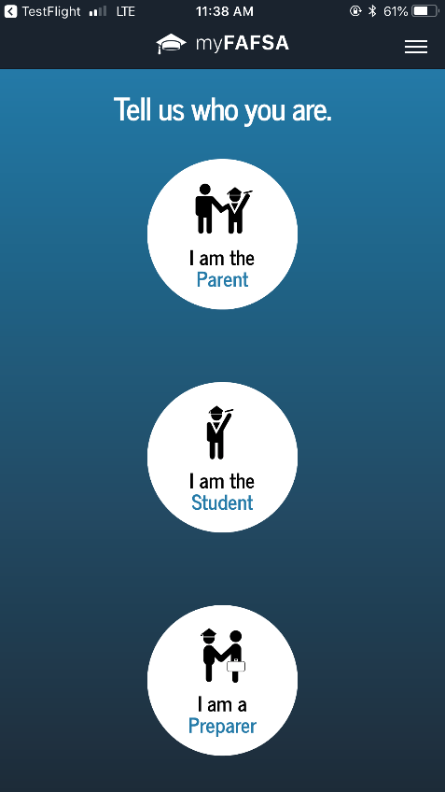
myStudentAid Mobile App
Mobile ability to begin, complete, save, and submit the FAFSA

Slide 15
IRS Data Retrieval Tool (DRT)
Allows for certain tax return information to be transferred from the IRS database
Participation is voluntary and student chooses whether or not to transfer data to FOTW
IRS will authenticate taxpayer’s identity
If tax record is found, IRS transfers information to populate the FAFSA
Reduces documents requested by financial aid office

Slide 16
IRS Data Retrieval Tool
Certain tax filers cannot use the
IRS Data Retrieval Tool
Did not indicate on FAFSA a tax return was completed
Marriage date is January 2019, or later
First three digits of the SSN are 666
Filed a non-U.S. tax return
Married and filed as head of household, or filed separate returns
Neither married parent entered a valid SSN
Non-married parent or both married parents entered all zeroes for the SSN

Slide 17
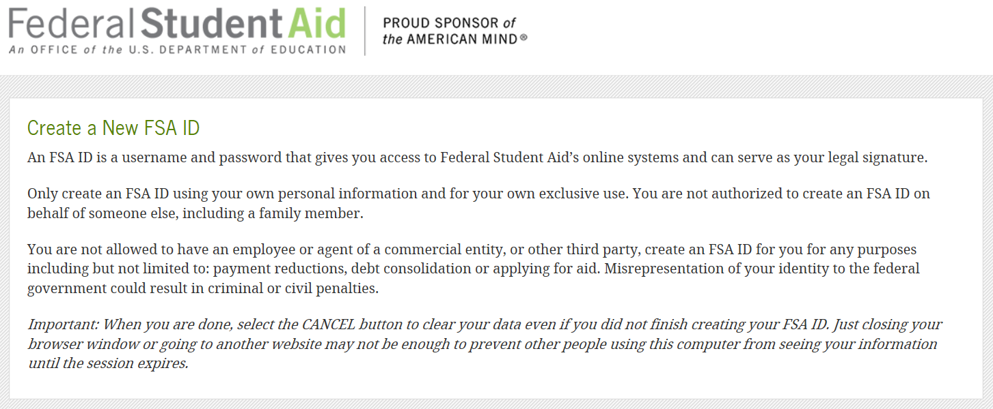
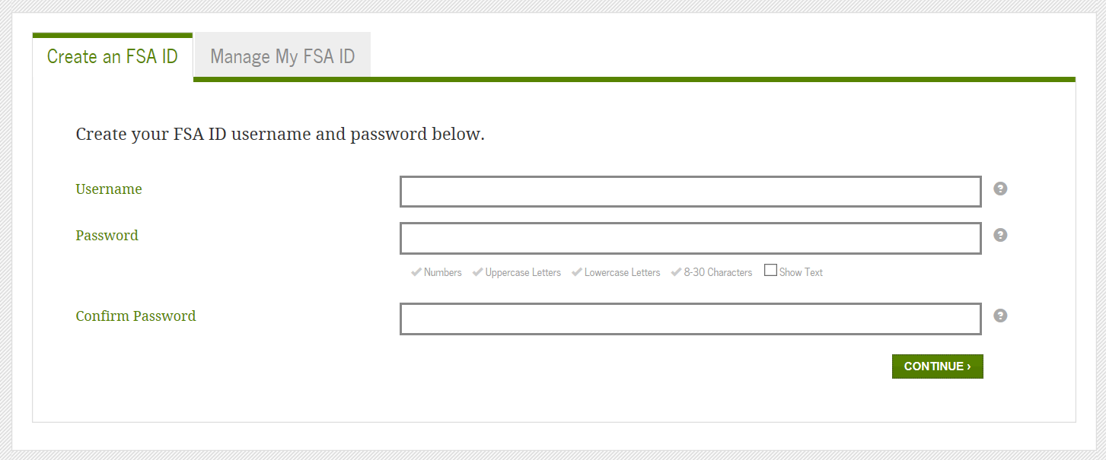
FSA ID
Necessary for access to all federal student aid websites
May be used by students and parents throughout financial aid process, including subsequent school years
Only the owner should create FSA ID
Apply at https://fsaid.ed.gov/npas/index.htm

Slide 18
Common FAFSA Errors
Social Security Numbers
Divorced/widowed/remarried parental information
Income earned by parent/stepparent
Untaxed income
U.S. income taxes paid
Household size
Number of household members in college
Real estate and investment net worth

Slide 19
Making Corrections
If necessary, corrections to FAFSA data may be made by:
Using FAFSA on the Web, if student has FSA ID;
Updating paper SAR; or
Submitting documentation to the Financial Assistance Office.

Slide 20
FAFSA Verification
Verification is the process to confirm information provided on FAFSA is accurate
Approximately 33% of all completed FAFSAs will be selected for verification
Verification will be noted on your electronic Financial Aid Offer
Failure to complete verification may result in the loss of federal aid
Contact the Financial Assistance Office with questions-

Slide 21
Know Your State Grant Deadlines
Delaware State- deadline for application March 15
https://www.doe.k12.de.us/Page/996
800-292-7935
Pennsylvania State – deadline for application May 1
www.pheaa.org
800-692-7392

Slide 22
Types of Loans
Subsidized Federal Loan
Need based- no interest accruing while student is enrolled half time
Unsubsidized Federal Loan
Interest is accruing from disbursement
Parent Plus Federal Loan
Parent unsubsidized loan-
Graduate Plus Federal Loan
Graduate unsubsidized loan-
Private/Alternative Loans
Lenders and interest rates vary

Slide 23
Scholarship Opportunities
Neumann University website
Major search engines
Scholarships.com
Fastweb.com
Collegeboard.org
Sallie Mae
Chegg
Local Scholarships
Check High School Guidance Office
Start early, apply to many and follow all directions

Slide 24
Neumann University Financial Assistance Office Contact our office with any questions or issues 800-9-NEUMANN 610-558-5521 finaid@neumann.edu

